Slide 1
9- Type Conversion

Slide 2

Input(“something”)
Now let's take a look at another useful built in function in Python
We use the input function to get input from the user as an argument that pass a string. This will be a label that will be displayed in the terminal.
This function returns a string so we can store it in a variable

Slide 3
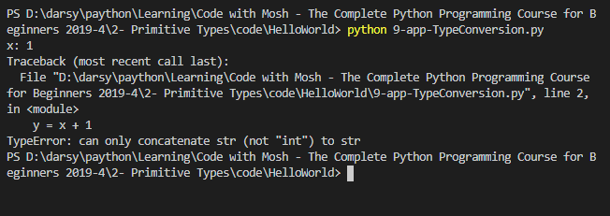
Don't run this program using the code Runner extension because code runner by default runs your program in the output window. which is read only so you won't be able to enter a value.
So open up the terminal

Slide 4

We got an error type error.
TypeError
when we receive input from the user, this input always comes as a string
so y = x + 1 expression at runtime will look like this “1” + 1
Note that the number one is different from string one because these are two different types.
Now when Python sees this expression it doesn't know what to do because two objects can be concatenated if they are of the same type

Slide 5
So here we need to convert “1” to a number.
In Python we have a few built in functions for type conversion.
int(x)
For converting a number to an integer.
float(x)
bool(x)
str(x)

Slide 6
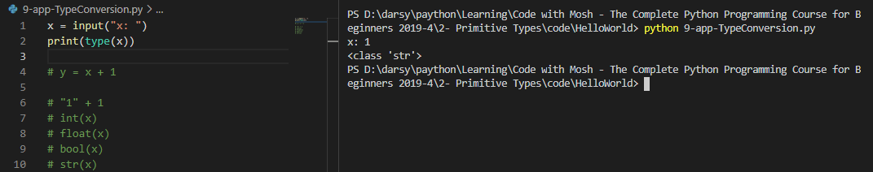
type is another built in function. We pass an object as an argument and it returns its type

Slide 7
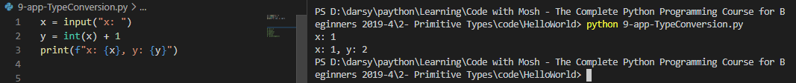
To fix this problem we need to convert X to an integer.

Slide 8
all these built in functions are self explanatory.
The only tricky one is bool because in python we have this concept of truthy and falsy values.
These are values that are not exactly a Boolean True or False. But they can be interpreted as a boolean True or False

Slide 9

We have an object called None which represents the absence of a value.
So whenever we use these values in a boolean in context will get false.
Anything else will be True.

Slide 10
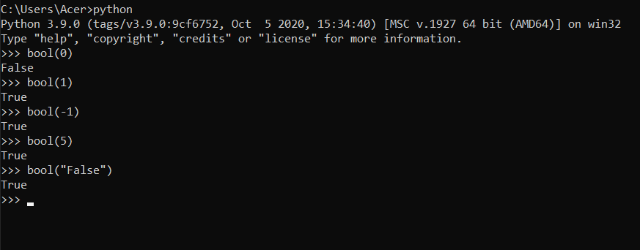
Open cmd
Type python

